Slide 1
Digital Image Processing
ET4591E

Slide 2

Image to Cartoon
Student: Vu Minh Dung – 20224279
Nguyen Duy Anh – 20224278
Lecturer: PhD. Tran Thi Thanh Hai
SCHOOL OF ELECTRICAL AND ELETROCNIC ENGINEERING
HANOI UNIVERSITY OF SCIENCE AND TECHNOLOGY

Slide 3
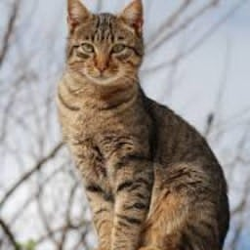
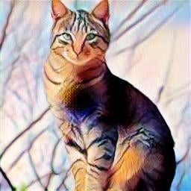
Introduction
Problem statement
Input/Output
Challenge
- Transforming real-life images into cartoon-style representations is a complex image processing challenge. This project utilizes Generative Adversarial Networks (GANs) to automatically convert real-world images into high-quality cartoons, maintaining essential features and enabling applications in animation, design, and creative industries.
Gathering diverse, high-quality data was challenging, requiring meticulous preprocessing to handle noise and inconsistencies.
Training demanded careful hyperparameter tuning, prevention of overfitting, and efficient handling of large datasets within computational limits.
Figure 1: Reality
Figure 2: Cartoon

Slide 4
Related works
Non-photorealistic rendering (NPR)
+ Algorithms replicating artistic styles like cartoons often use cel shading to achieve flat shading effects commonly seen in games and animations.
+ Face challenges in capturing complex abstractions and general applicability.
Image synthesis with GANs
+ GANs excel in image synthesis tasks but face challenges in stylization; while CycleGAN enables unpaired image translation, it struggles with cartoon stylization, which the proposed method addresses through a specialized GAN model and tailored loss functions for efficient photo-to-cartoon translation.

Slide 5
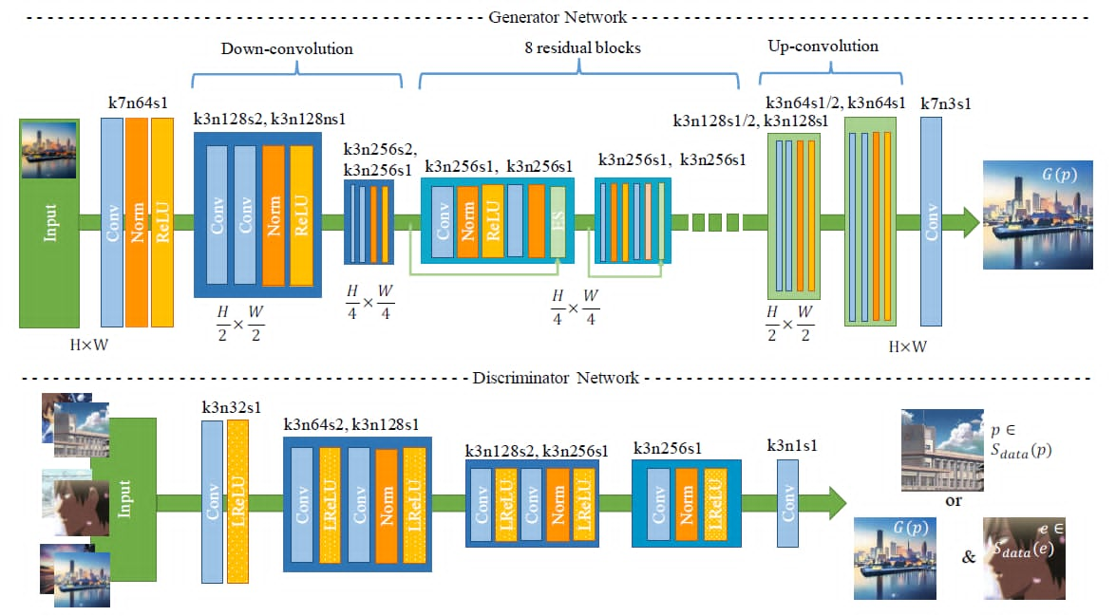
Proposed method
Fig.3 : Architecture of the generator and discriminator networks in the proposed CartoonGAN

Slide 6
Experiments
1.Data
- The training data consists of 4,000 real-world photos from cocodataset.org and 4,000 cartoon images from safebooru.org, with 80% used for training and all images resized and cropped to 256×256.
- An ablation experiment on CartoonGAN showed that the initialization phase helps the generator converge quickly, VGG feature maps address style differences between cartoon and photo images, and edge loss enhances the clarity of edges, improving the cartoon style of the generated images.

Slide 7
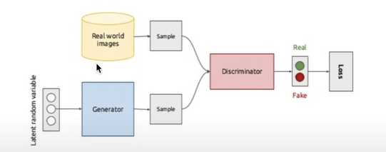
Experiments
2.Implement -
Fig.4 :Generator and discriminator

Slide 8
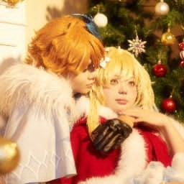
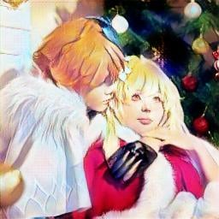
Result
1.Example -
Fig.5 : Input
Fig.6: Output

Slide 9
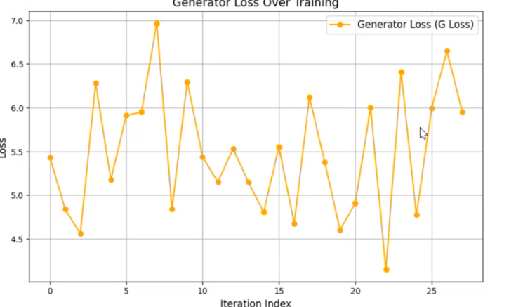
Result
2.Loss -
Fig.5 : Generator loss

Slide 10
THANK YOU !

